Slide 1
P_mers
Move together, Work together
Develop solutions and approaches for addressing social and human issues.
28/05/22

Slide 2
INTRODUCTION
“Give a man a fish and you feed him for a day; teach a man to fish and you feed him for a lifetime.”
We have made a prototype which ensure helping hand towards farmers, as these days use of technologies in variety of fields has increased drastically, which influences us to make the best utilization of it. We present you “KRISHI SAHAYATA”, an app that helps farmers to enhance their products and yield in the best possible manner using the latest technologies available.
This app will provide finest suggestion to grow their crops, based on the basics information that the farmer has input to the app.

Slide 3
User segment
Primary user are farmers for whom this applications is introduced.
Farmers can also use our app to purchase farm supplies and sell their products.
Farm supply vendors can also use our application for selling their goods.
Students can also learn about different farming techniques, crops, etc. through our app.

Slide 4
Current Landscape
Currently there are only some govt. issued applications in this segment, which still does not uses the latest technology like AI and ML. We have planned to implement the most updated technologies that are available with Microsoft Azure to make it more productive for the end users i.e. farmers.

Slide 5
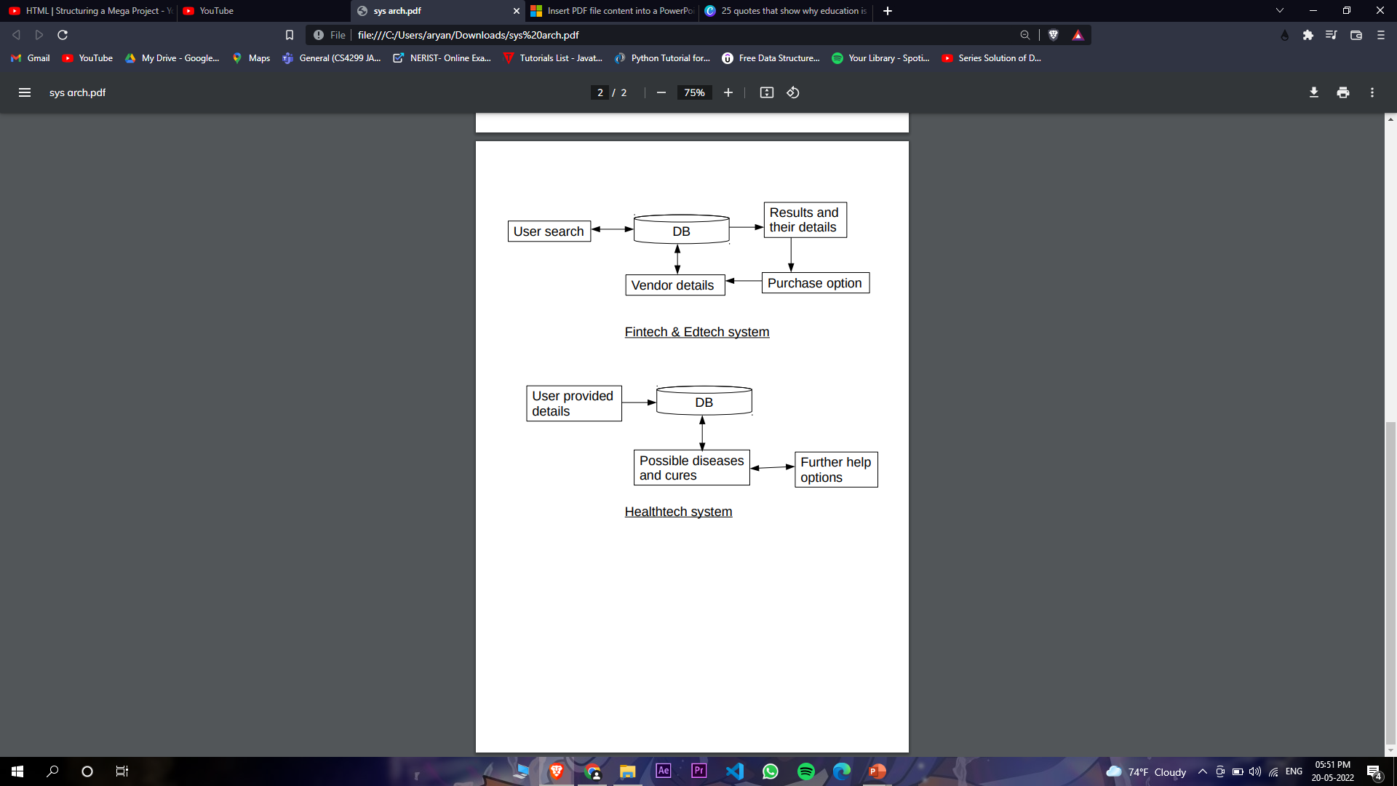
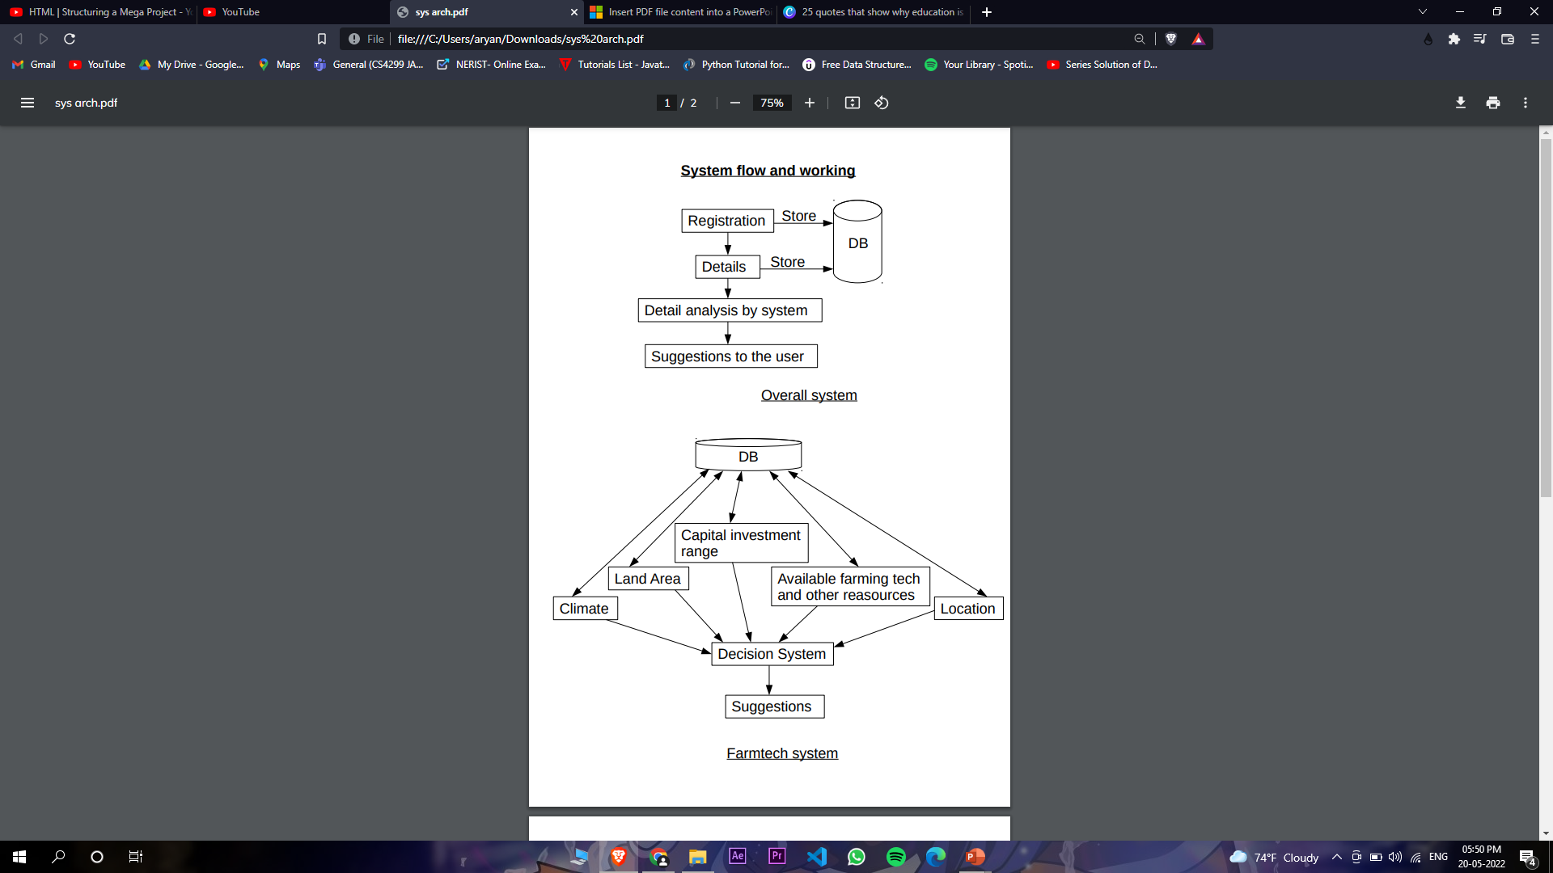
System architectures

Slide 6
Key Differentiators
1. Helps farmers with getting max profit and yield.
2. Provides health information of the crops to farmers.
3. Provides educational information about the crops.
4. Help the farmers in purchasing good and cheap farm supplies.
5. Connect vendors with the farmers.
6. Provide most viable farming solutions to the farmers, based on the details
they provide and our previously recorded datasets.

Slide 7
FUTURE VISION
Voice chat
The app currently uses only text based communication (chatbot) with the user but in future updates we are planning to implement voice chat feature (voice-bot) in the application so that communication between the user and the app is more realistic and fluent.
AI integration.
Currently the app will be using a Q&A system to reply to any query that the user may have which will help them get the answers to most of the basic questions. But for more complicated queries we will be using Azure AI services along with the data collected by us, to better understand the user’s need and respond accordingly.

Slide 8
Thank You
Vivek Kumar Sah
Preyum Kumar
Sayan Das
Aryan Gupta

